Slide 1
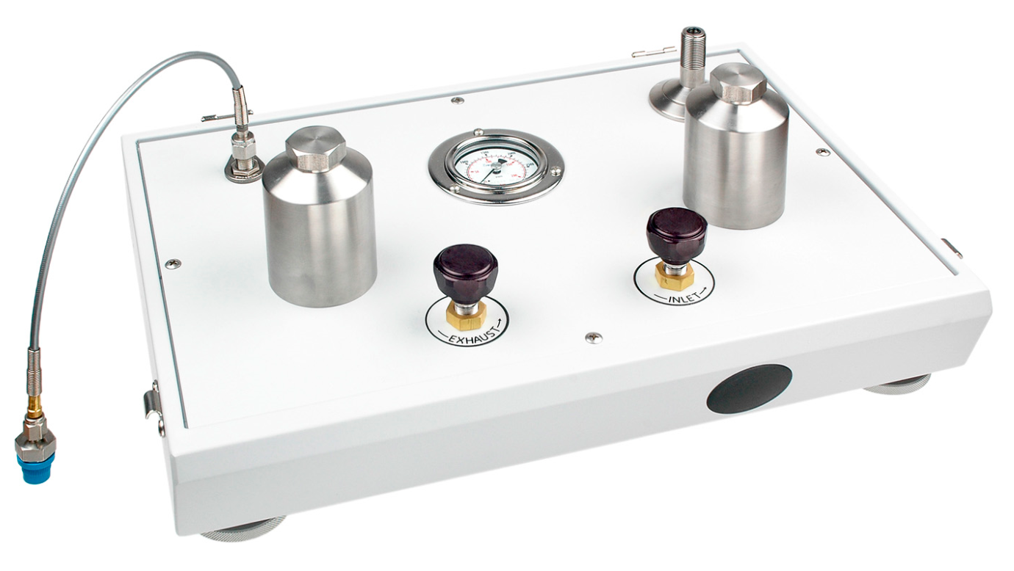
P5523 Oil-to-Gas Separator
N2 gas bottle source input – connects to
¼ NPTf port on rear.
DUT (gas) connection here
The P5523 is used to transfer oil pressure to gas pressure. It does this through a direct fluid interface. The control valves are used to meter in gas pressure from a high pressure source (such as a bottle) and balance it against the hydraulic pressure.
Prime the DWT and the connection hose leading to the P5523 with oil . Following the “Priming” instructions in the P5523 manual.
Load the weights required to float the piston.
Generate the pressure by using the gas control valves on the P5523. This will apply pressurized gas to the oil which in turn will lift the piston into float.
Note: the DWT screw press is not used to bring the piston into float. Only use the screw press for fine adjustments to the system pressure
Make small adjustments to the float position with the DWT screw press until the oil DWT has attained equilibrium = floating and dropping at its natural drop rate.
Connect to oil DWT
Reservoir Cap

